Slide 1

MEIOSIS CELL DIVISION
Course: BIO 101: Introduction to Biology
Chapter: 9

Slide 2
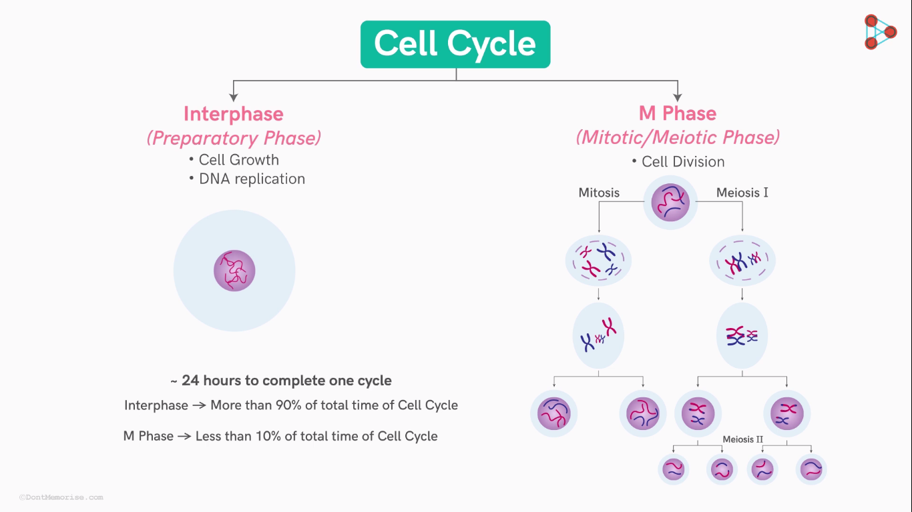
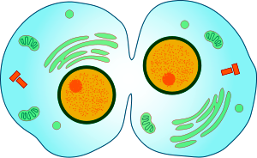

Slide 3
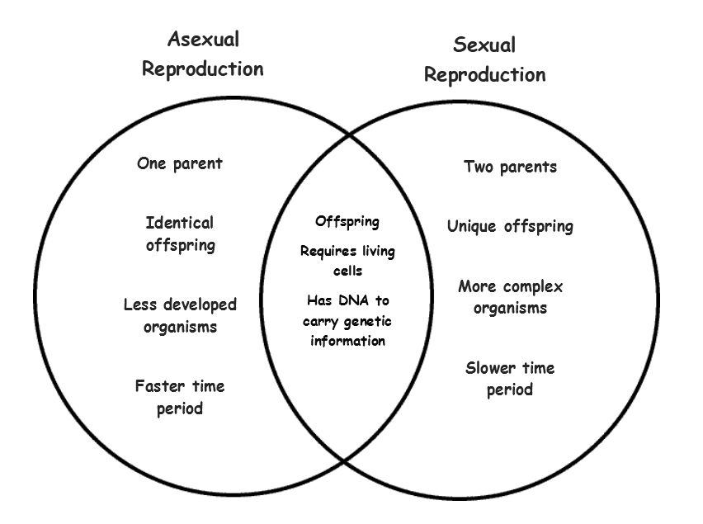

Slide 4
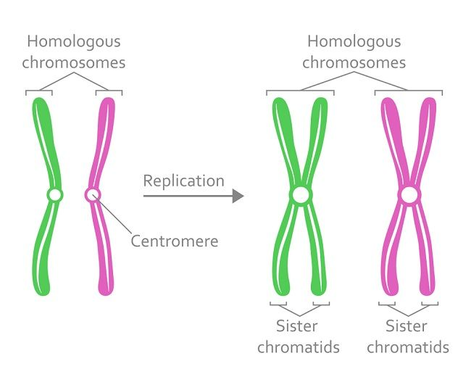
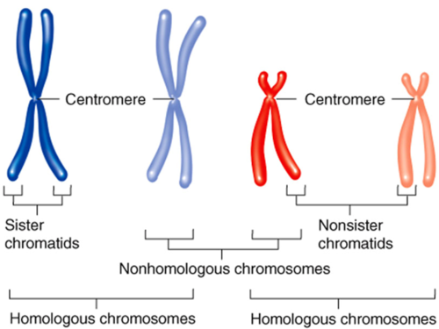
HOMOLOGOUS CHROMOSOMES

Slide 5
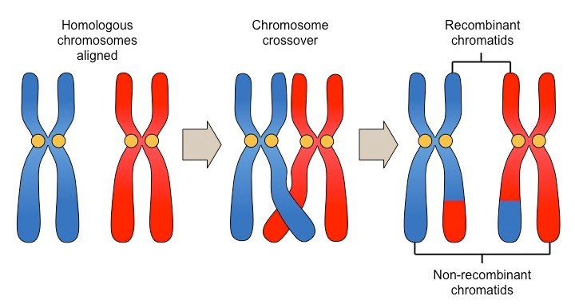
CROSSING OVER
Each chromosome becomes zippered to its homologue
All four chromatids are closely aligned
Non-sister chromosomes exchange segments
After crossing over, each chromosome contains both maternal and parental segments

Slide 6
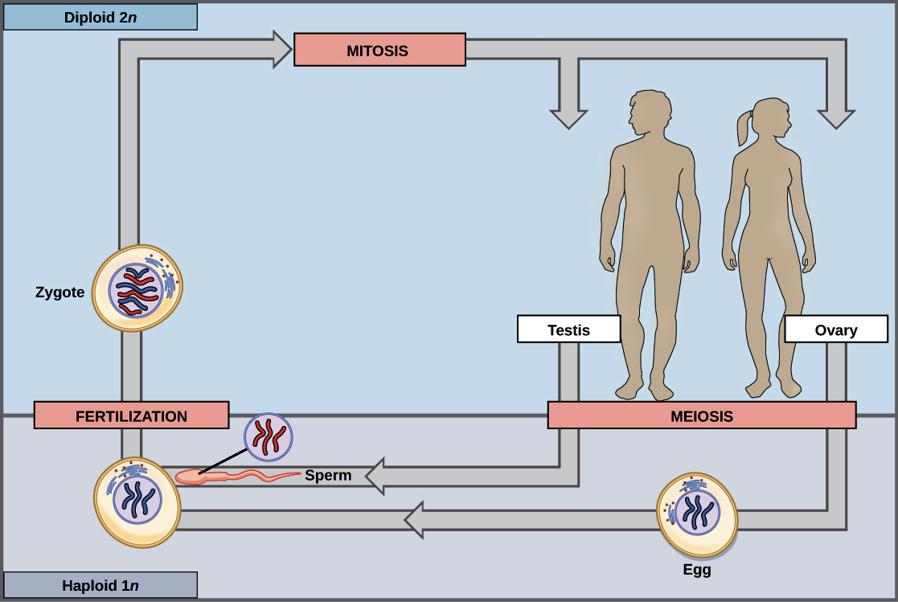
M PHASES IN HUMAN
Germ cells (2n) undergo meiosis to produce gametes (n)
Gametes are sex cells (sperm, eggs) & meet at fertilization

Slide 7
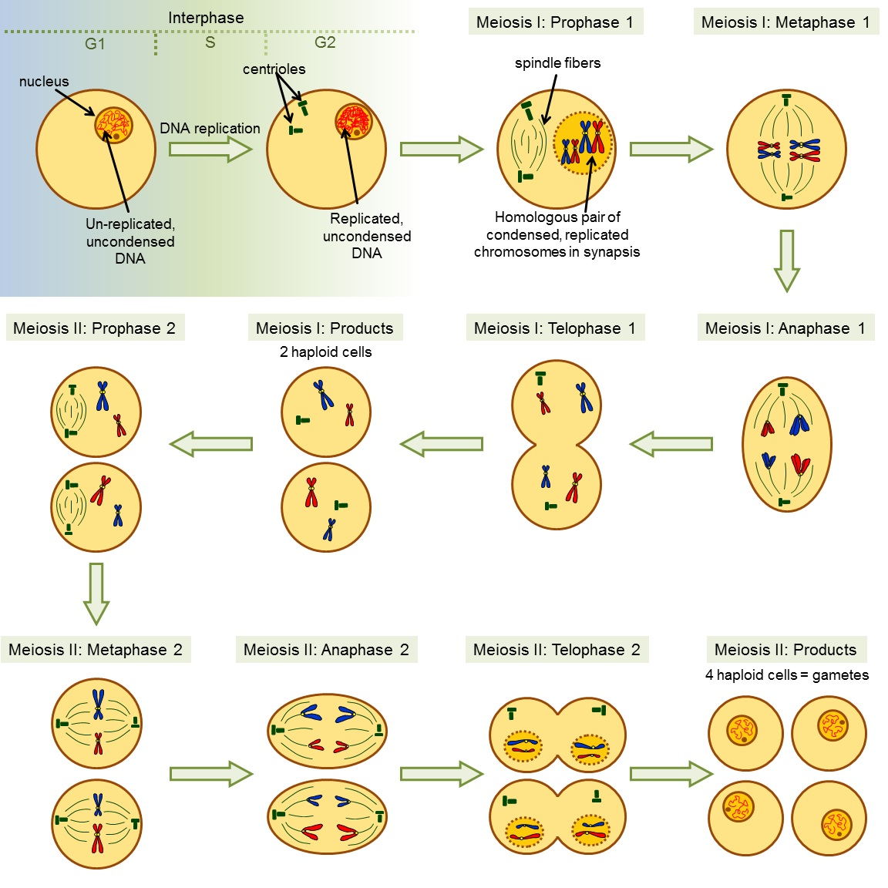
MEIOSIS
Two consecutive nuclear divisions
Meiosis I
Meiosis II
DNA is NOT duplicated between divisions
Four haploid nuclei are formed
Meiosis I
Prophase I
Metaphase I
Anaphase I
Telophase I
Meiosis II
Prophase II
Metaphase II
Anaphase II
Telophase II

Slide 8
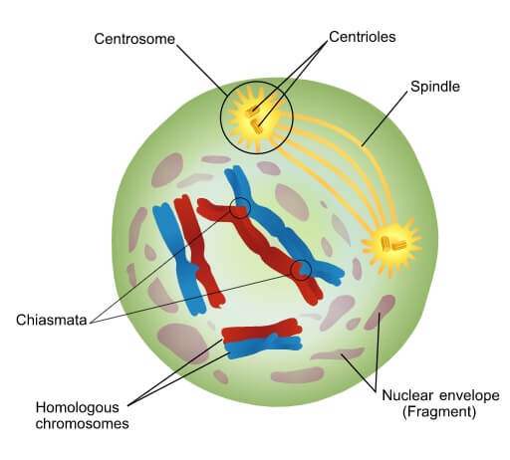
Meiosis I
PROPHASE I
Each duplicated, condensed chromosome pairs with its homologue
Homologues swap segments
Each chromosome becomes attached to microtubules of newly forming spindle

Slide 9
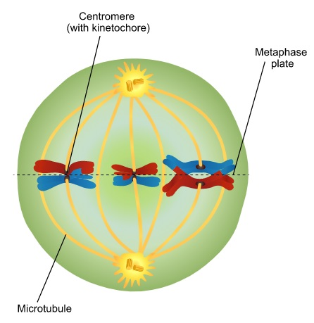
Meiosis I
METAPHASE I
Chromosomes are pushed and pulled into the middle of cell
Sister chromatids of one homologue orient toward one pole, and those of other homologue toward opposite pole
The spindle is now fully formed

Slide 10
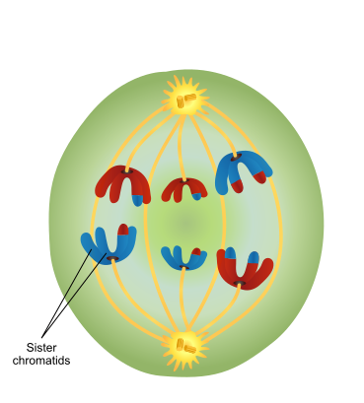
Meiosis I
ANAPHASE I
Homologous chromosomes segregate from each other
The sister chromatids of each chromosome remain attached

Slide 11
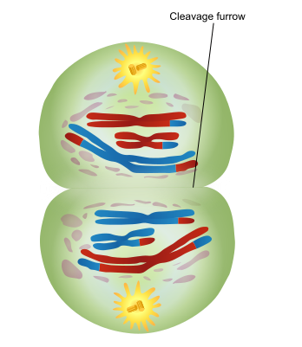
Meiosis I
TELOPHASE I
The chromosomes arrive at opposite poles
The cytoplasm divides
There are now two haploid cells
This completes Meiosis I

Slide 12
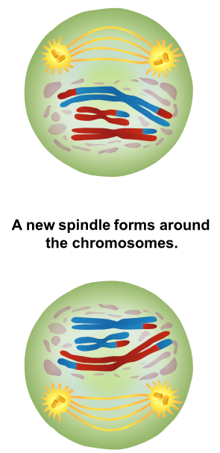
Meiosis II
PROPHASE II
A new spindle forms around the chromosome
Microtubules attach to the kinetochores of the duplicated chromosomes

Slide 13
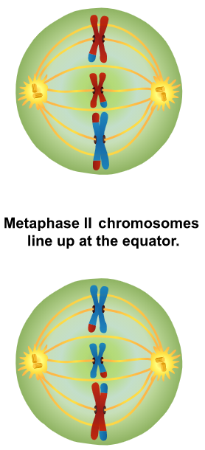
Meiosis II
METAPHASE II
Chromosomes are pushed and pulled into the middle of cell
All of the duplicated chromosomes are lined up at the spindle equator, midway between the poles

Slide 14
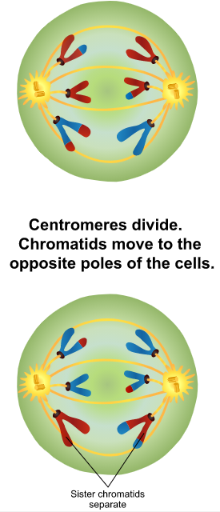
Meiosis II
ANAPHASE II
Sister chromatids separate to become independent chromosomes

Slide 15
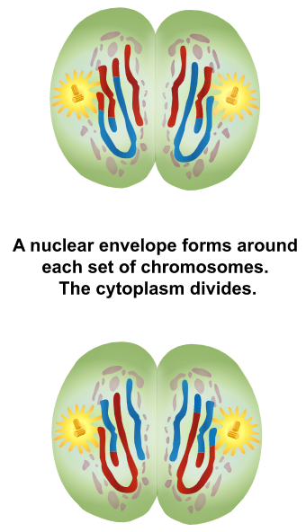
Meiosis II
TELOPHASE II
The chromosomes arrive at opposite ends of the cell
A nuclear envelope forms around each set of chromosomes & the cytoplasm divides
There are now four haploid cells

Slide 16
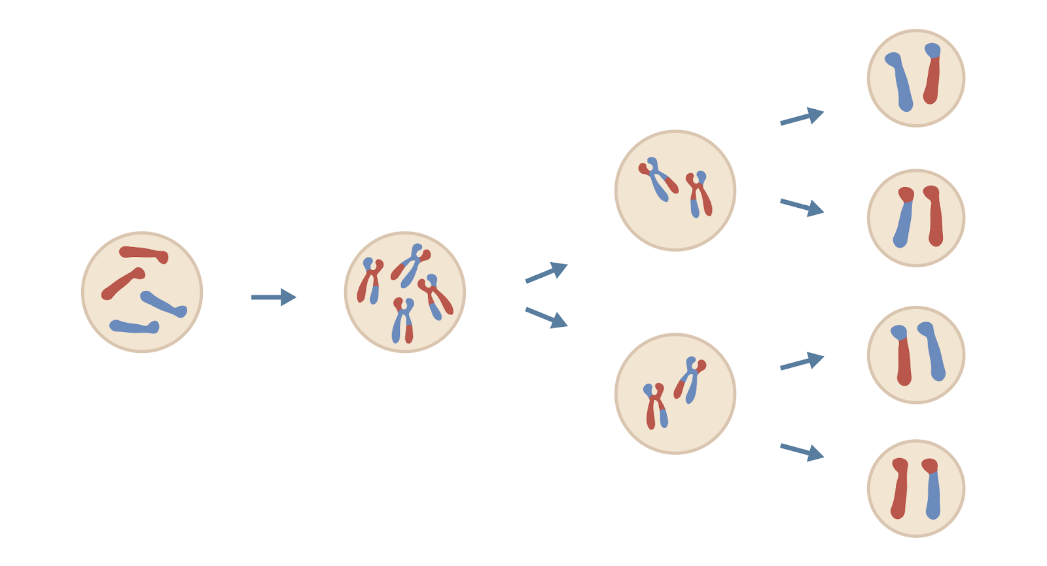
RESULTS OF MEIOSIS
Four haploid cells produced
Differ from parent and one another

Slide 17
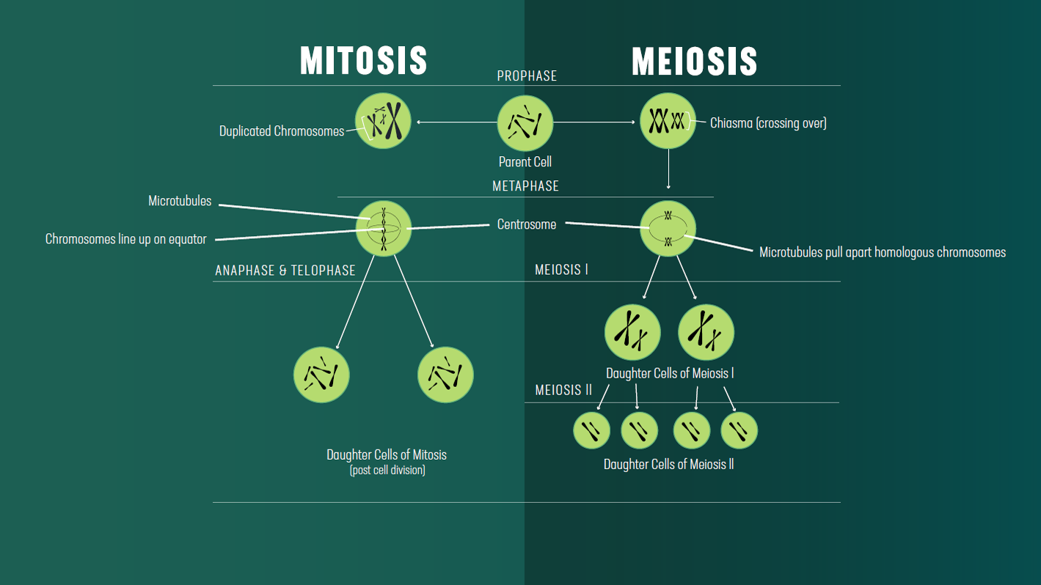

Slide 18
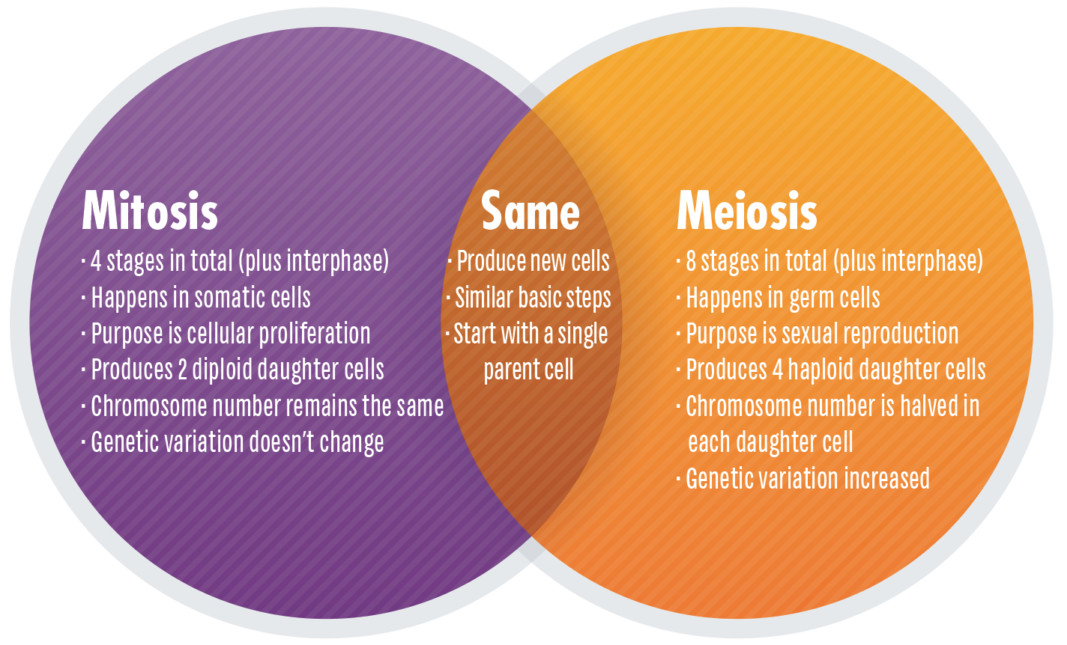

Slide 19
T
H
A
N
K
S

